Slide 1
Sentiment Analysis for Covid-19 Tweets
Presented by: Madhavi Pagare(109626035)
Harshith Repaka(110282130)

Slide 2
Introduction
Sentiment analysis is a technique for automatically identifying and categorizing subjective information in text data. Social media is Internet-based by design, enabling instantaneous electronic content sharing.
Whereas in social media platforms like Twitter, users can freely express their opinions, which can subsequently be shared with others. Public opinion analytics were helpful in determining the optimal public health response during the most recent COVID-19 outbreak.
The COVID-19 pandemic has demonstrated that the spread of false information, which is helped by social media and other digital platforms, poses a greater threat to global public health than the virus itself. The public's perceptions of social distance can be ascertained by examining articulated tweets.
We will look at Twitter client conduct considering covid -19 related events. We will look at the tweets and search for keywords with an end goal to gauge client conduct and disease transmission. The tweets will be separated in a critical manner by hashtags.
This will support expecting the spread of the ailment and help with breaking down client reactions to immunization, new flare-ups, and sickness recuperation.

Slide 3
Motivation
One of the main motivations is to forecast how diseases spread and how individuals will respond to new information about them. This can be used to predict whether there is an increase in new COVID instances in any location or whether there will be a new outburst if users behave in a specific way. It will also be useful to assess false information based on the quantity of retweets and the tweet's origin.
Users who have hashtags for COVID-19 may receive recommendations for tweets with high connectivity, as measured by the number of retweets. This can enable people who have been exposed to the disease to find the most relevant information from reputable sources like the World Health Organization (WHO) and Food and Drug Administration (FDA).
Users can be recommended tweets with a high connection number of retweets if they have hashtags linked to COVID-19 that are more likely to be authenticated to get the most accurate information. The node with a more dense network may be thought of as more accurate, and the user who is primarily in a dense network can be thought of as an authentic source. If we examine a node containing data about a tweet and the user, a retweet can be thought of as an edge connecting two nodes.
The networkx, tweepy library and Python will be the foundation of our project, but as it develops, libraries like NLTK may be used to complete more specialized tasks, such as semantic reasoning on tweets rather than just a single word. We will be using Twitter API in order to read twitter data. Users can tweet about how vaccines function, how they might advocate vaccination, and how to enhance immunizations if they use the hashtag "no-vaccine," for instance.

Slide 4
Methods of implementation
->Visualizing the twitter network through twitter Api
To scrape Twitter for all of my followers and (most) their followers, use Tweepy.
From each of these connections, create a pandas DataFrame.
Run some network analytics using NetworkX to extract a network from these data.
network visualization in Gephi
->Network analytics using community detection algorithm for twitter
splitting the graph into groups using a community detection algorithm
run the degree centrality code
Visualize the graph

Slide 5
Methods of implementation
->Now, based on the keywords the user uses, we have designed a module that classifies a tweet as either a Positive or negative response.
To divide data sets into two separate categories of tweets—positive tweets that spread awareness and updates or bad tweets that sow fear—we utilized Termed Frequency Inverse Document Frequency (Tfidf Vectorizer).
If a tweet is unfavorable, we remind users of the most pertinent and encouraging updates. This might inspire users who are having a hard time getting through the procedure.
For users who have sent out Positive tweets, we implore them to continue doing so and to do so more regularly.

Slide 6
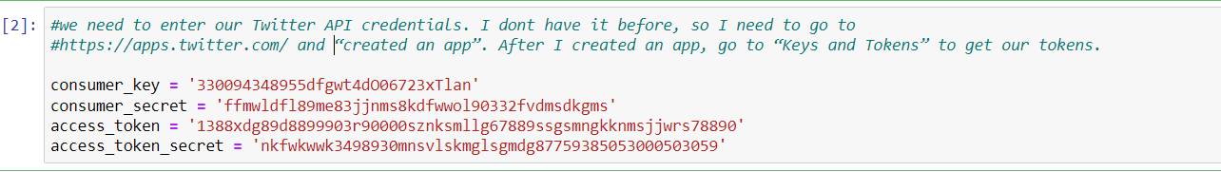
Results and discussion
Generated Twitter API Credentials:

Slide 7
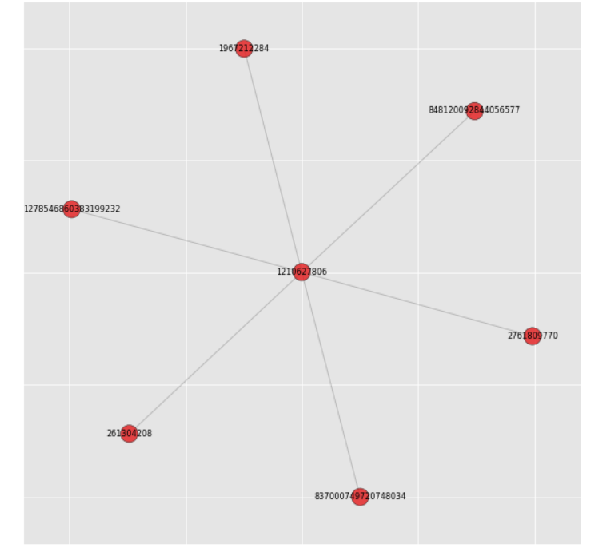
Results and discussion
With this smaller graph we can easily do some network analytics. We start by splitting the graph into groups using a community detection algorithm.
And visualize this graph

Slide 8
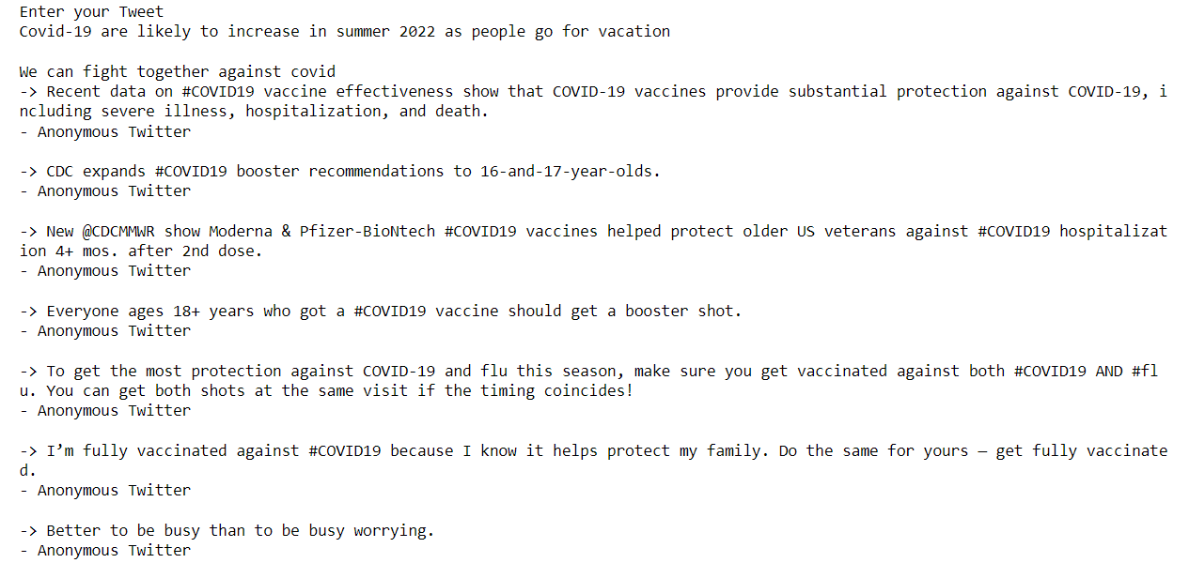
Results and discussion

Slide 9
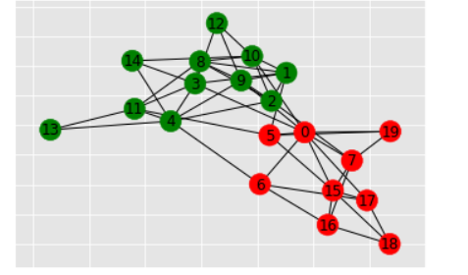
Results and discussion

Slide 10
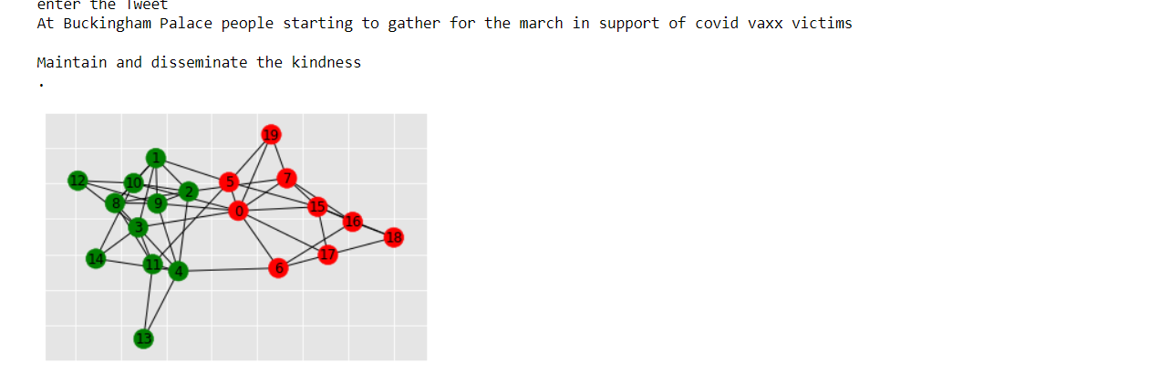
Results and discussion

Slide 11
Conclusion
All governments should immediately start using fact-checkers on social media to stop the spread of unneeded information in cases that are so seriously concerning. Laws can be created to enforce limitations on the dissemination of incorrect and pointless information during emergencies.
The features to attend multilingual tweets, which could be considered a likely future development in this area, are not present in this work. As a follow-up to this work, researchers can consider applying emotional intelligence to the tweets in order to more effectively examine people's sentiments.
Applying emotional intelligence to the tweets will also be beneficial for taking action to apply the proper filters to these tweets, preventing the elderly or sensitive persons (living alone) from being targeted by illnesses like depression and anxiety.
Other fuzzy rule-based methods should undoubtedly be investigated in order to produce improved sentiment identification outcomes.
In order to make it simple for statisticians, researchers, doctors, and people worldwide to have a one-stop solution for diseases like the dreaded COVID-19 that has kept the world devastated in the year 2020, a very urgent and necessary task could be done by gathering all the available resources and creating an all-in-one repository relating to this pandemic

Slide 12
Thank You

